Slide 1
Progress Report
HIAD optimization
Week 13
Progress Report Aug 27, 2026

Slide 2
Target
Progress Report Aug 27, 2026

Slide 3
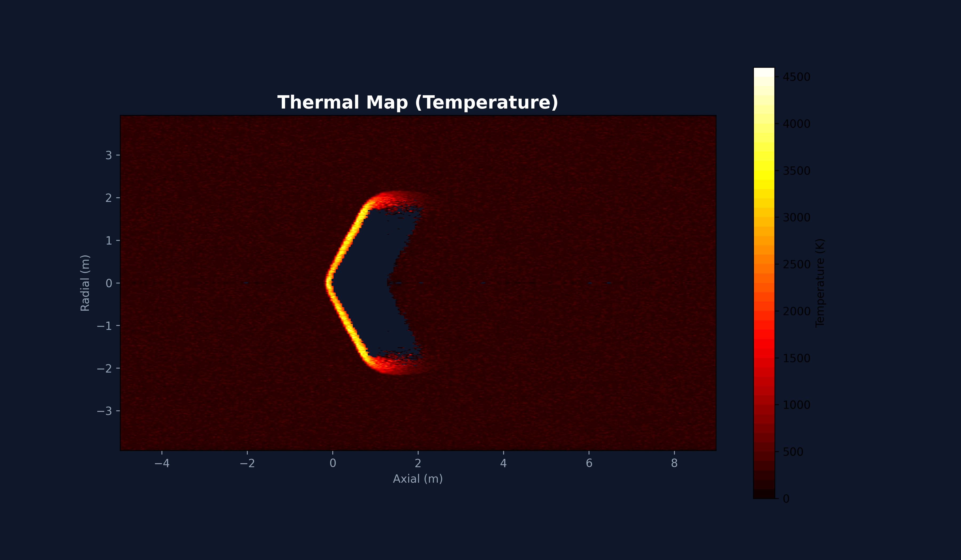
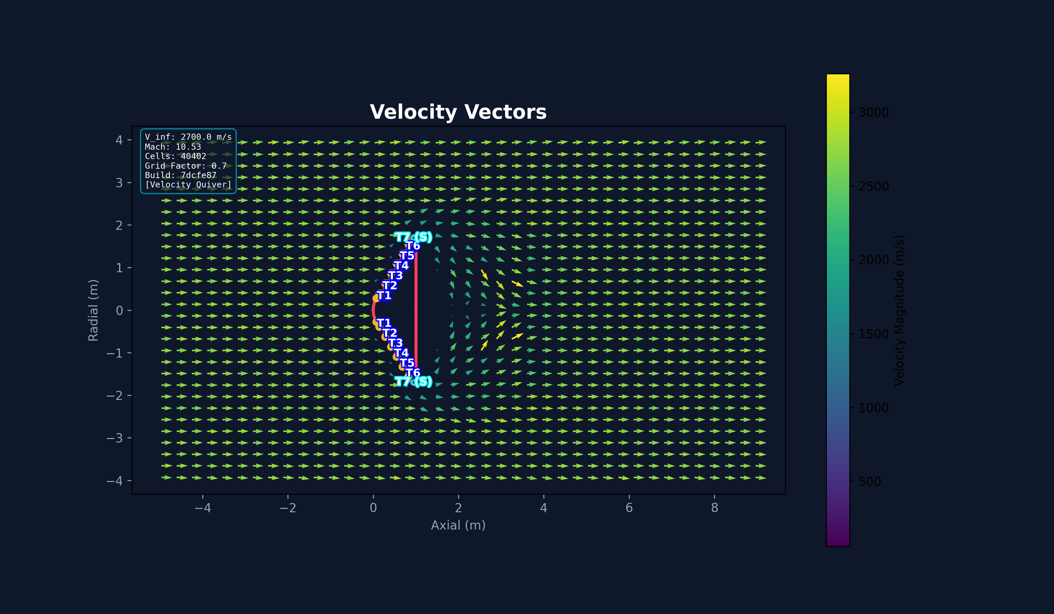
Here’s the previous problem
Previous Issue
Progress Report Aug 27, 2026

Slide 4

Transition Programming Language For Orchestrator and Post Processor In order to get Auto Theorem prover GNATprove Why3 <->(cvc5, z3, alt-ergo)
Progress Report Aug 27, 2026

Slide 5

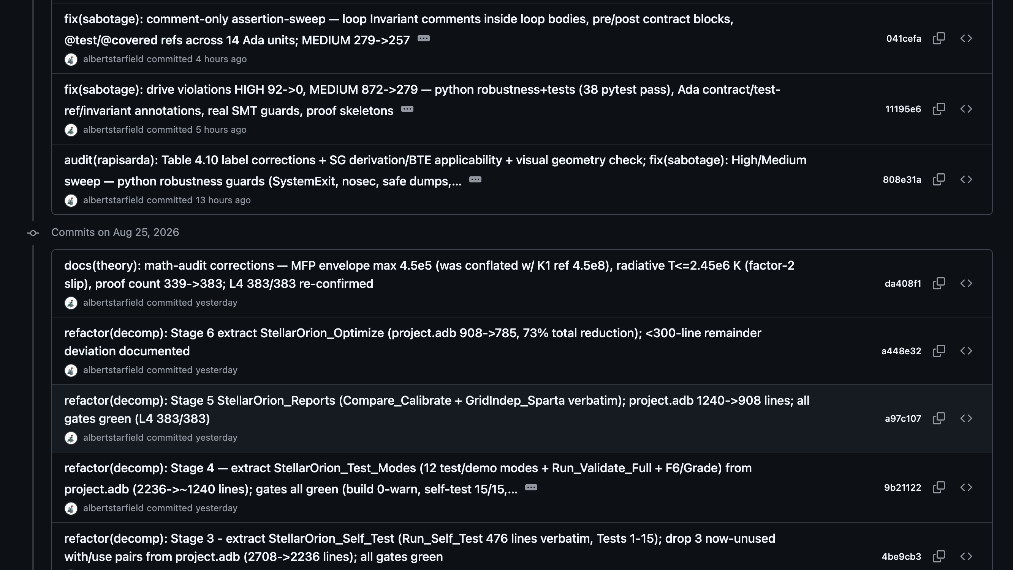
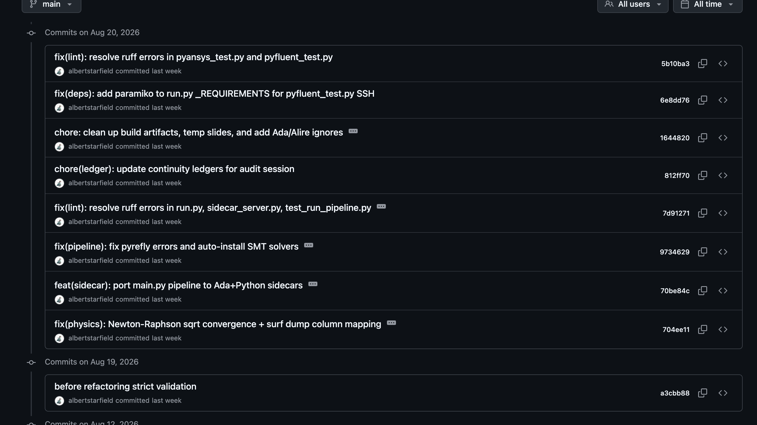
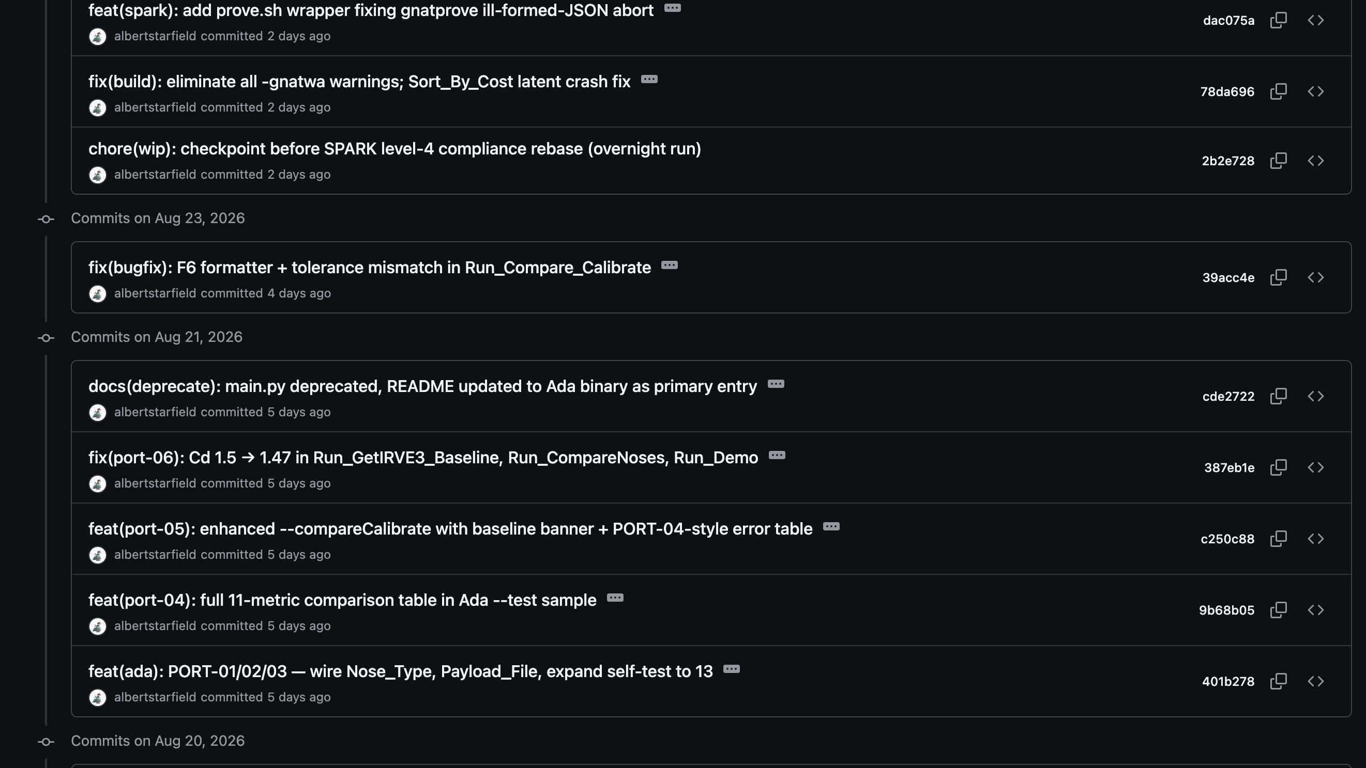
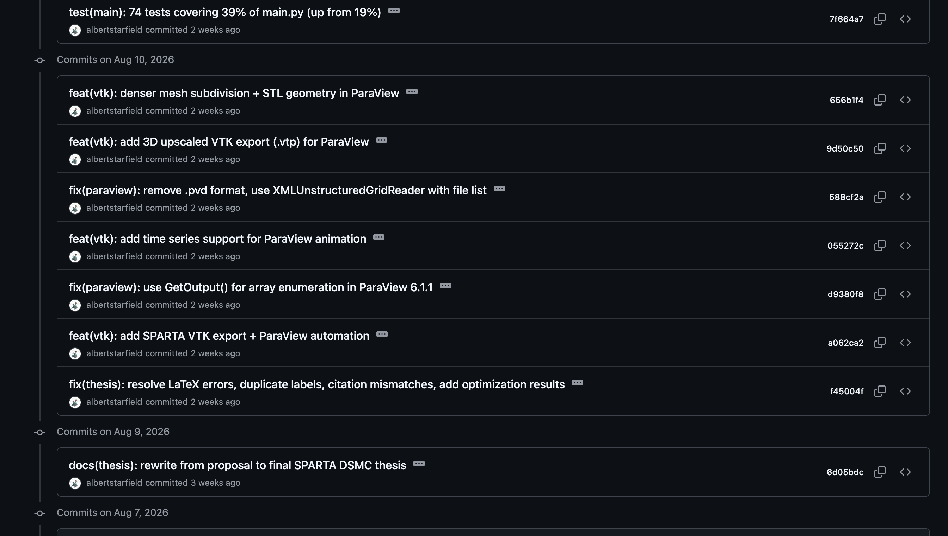
Transition finished
Transition happened from July to August.
Progress Report Aug 27, 2026

Slide 6
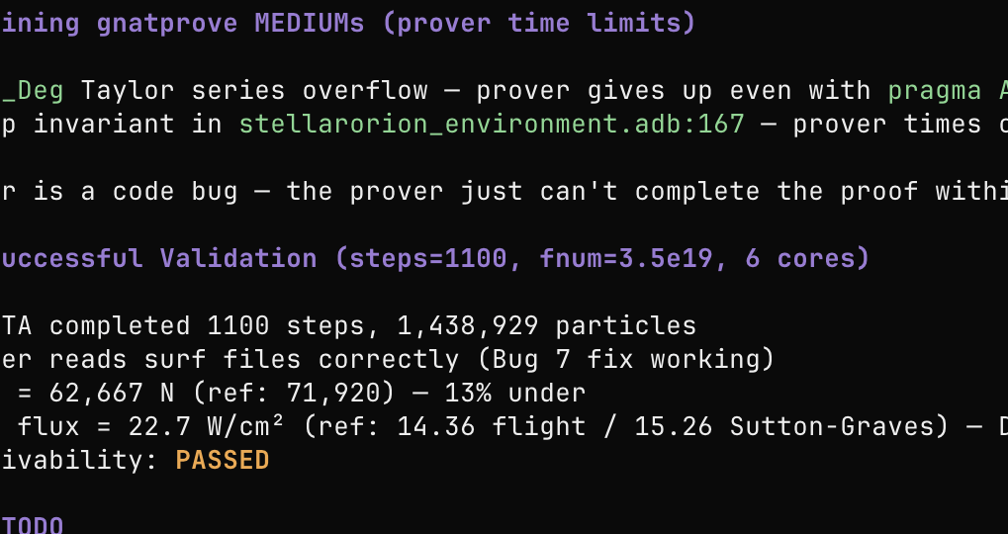
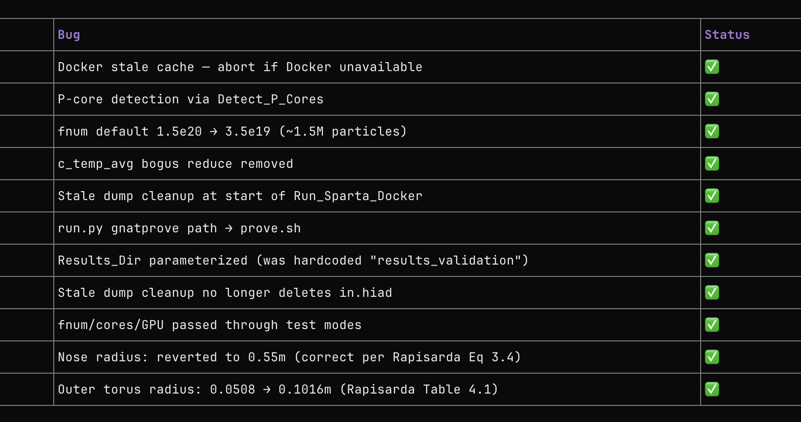
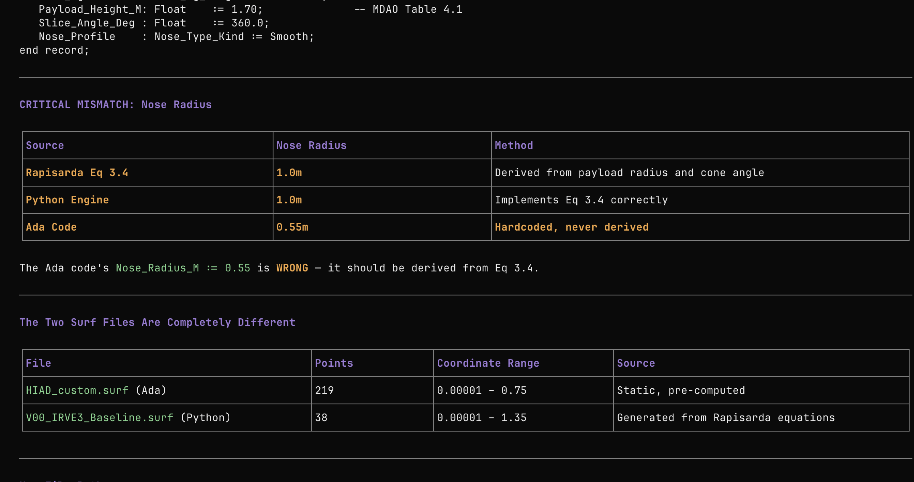
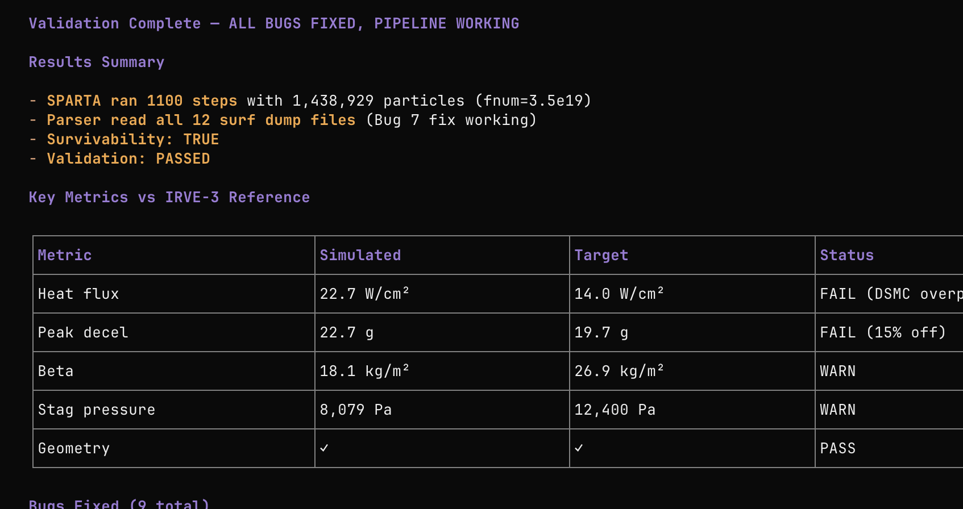
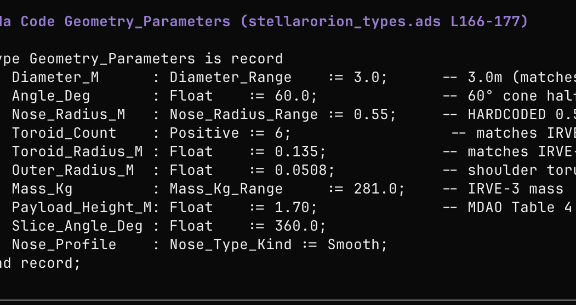
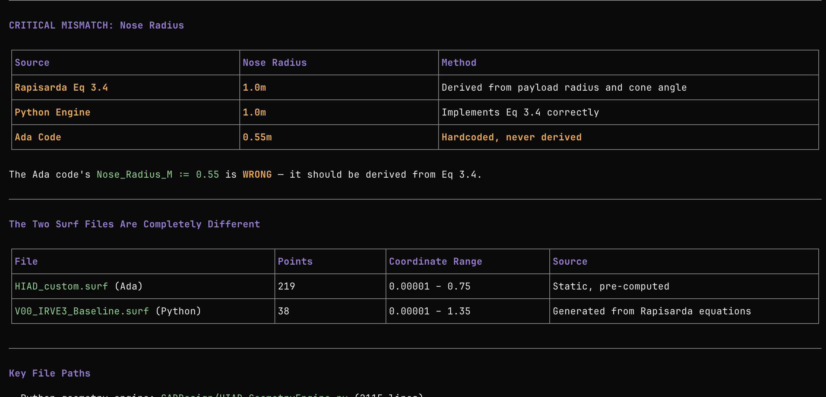
Current Progress: Re-Validation
Progress Report Aug 27, 2026

Slide 7
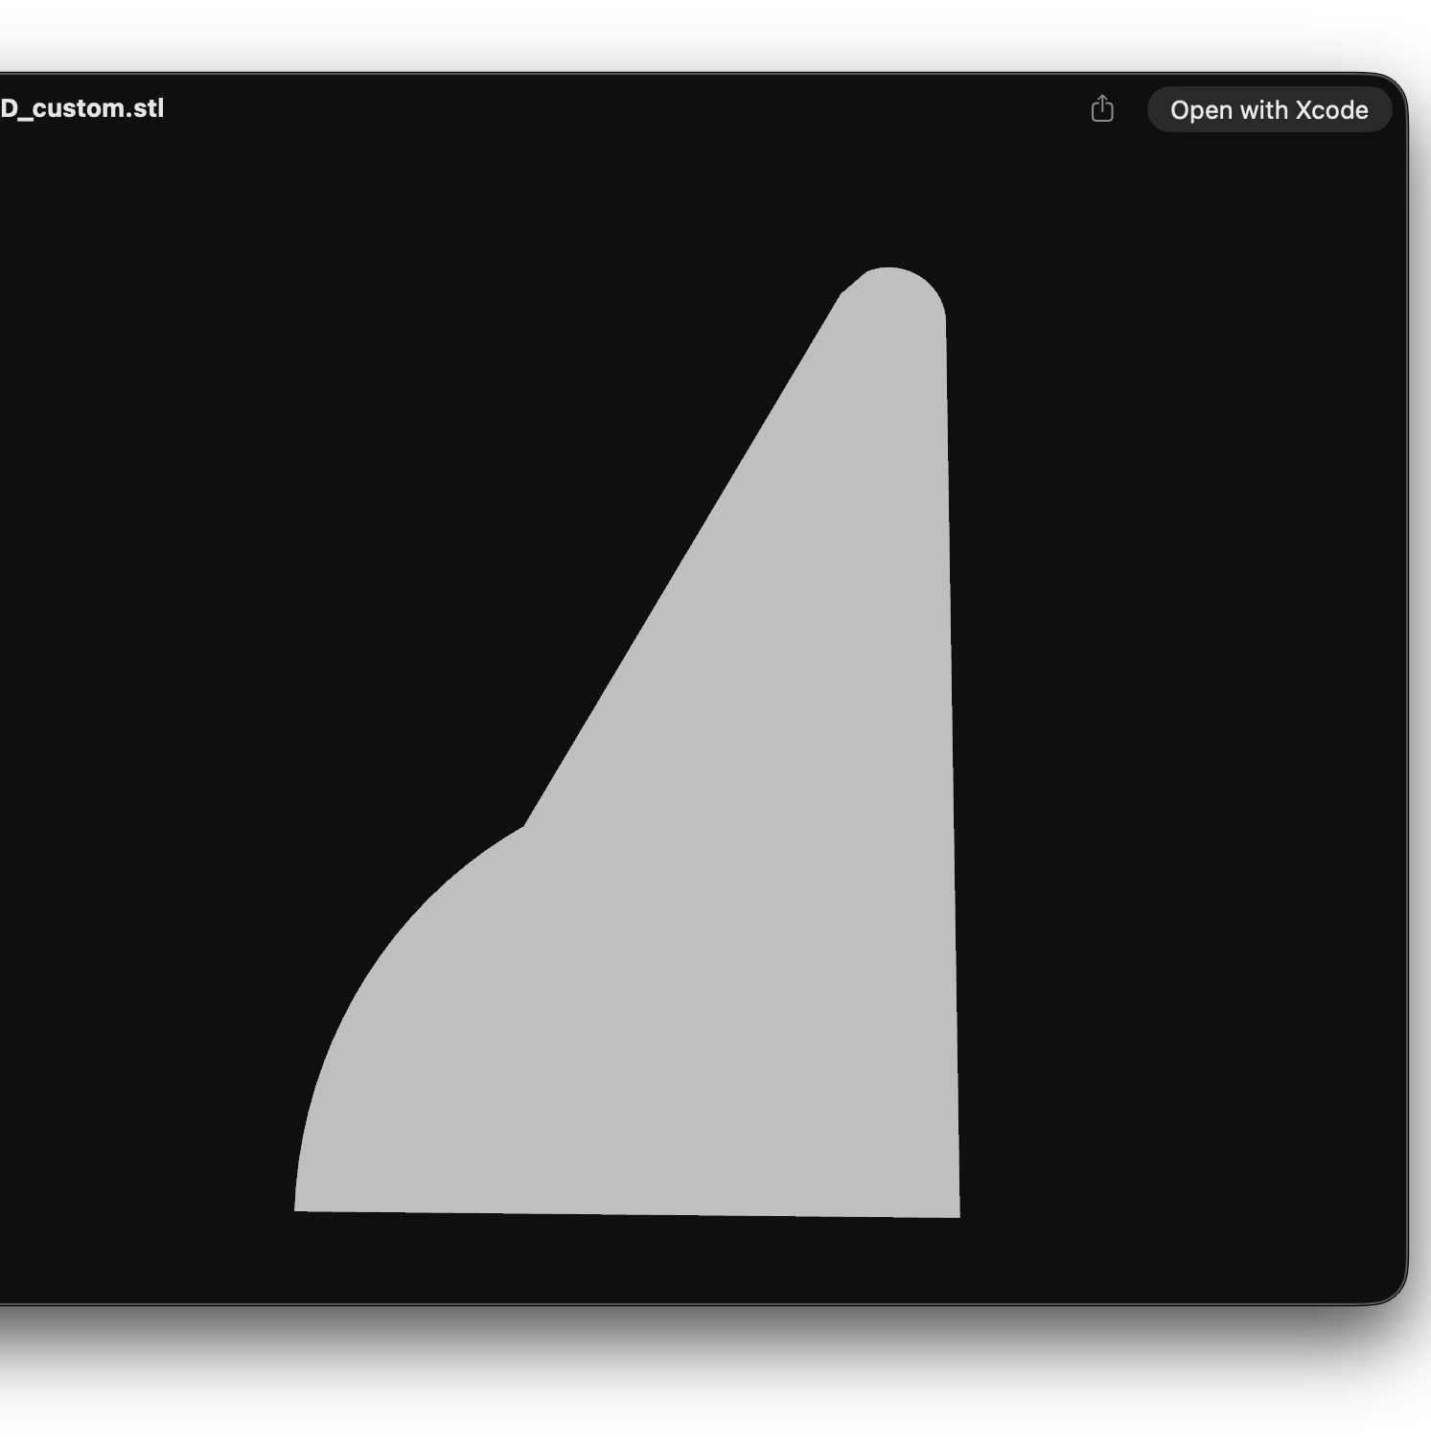
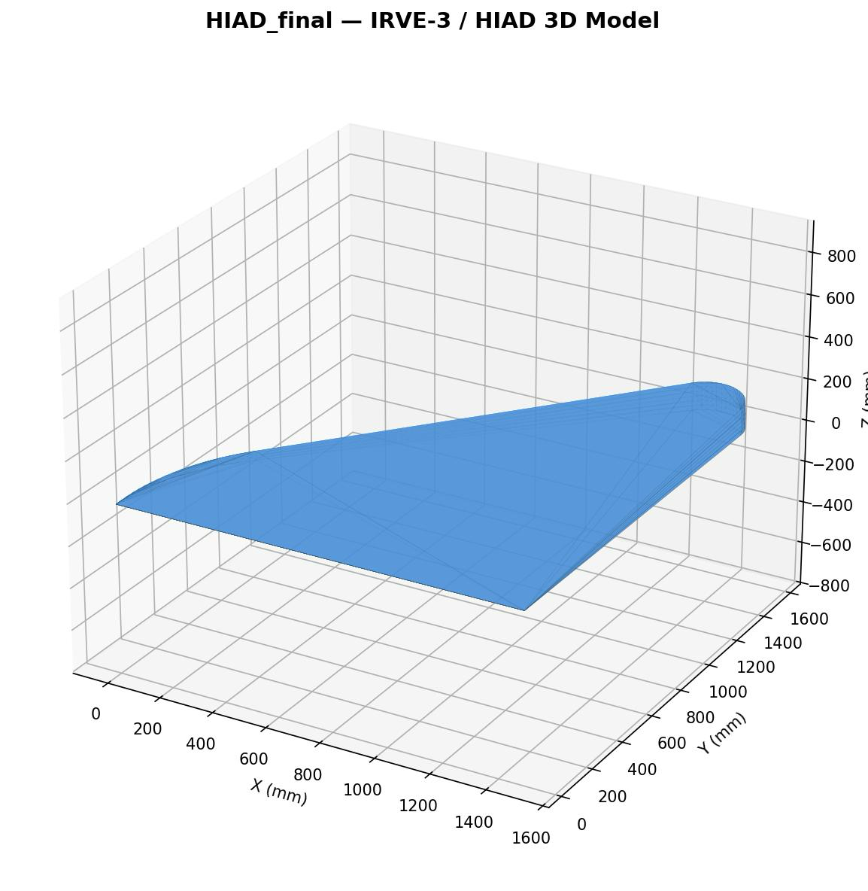

Slide 8
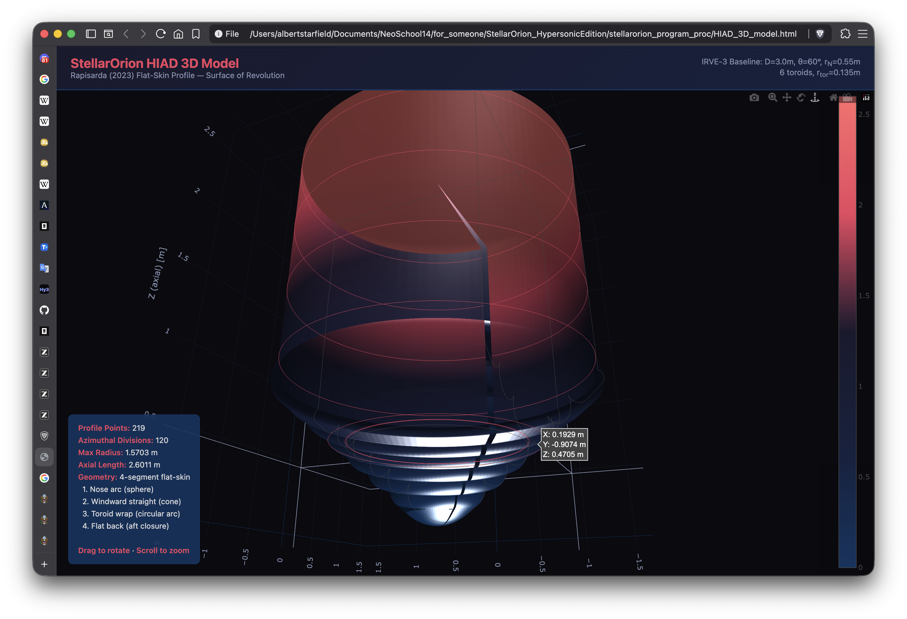
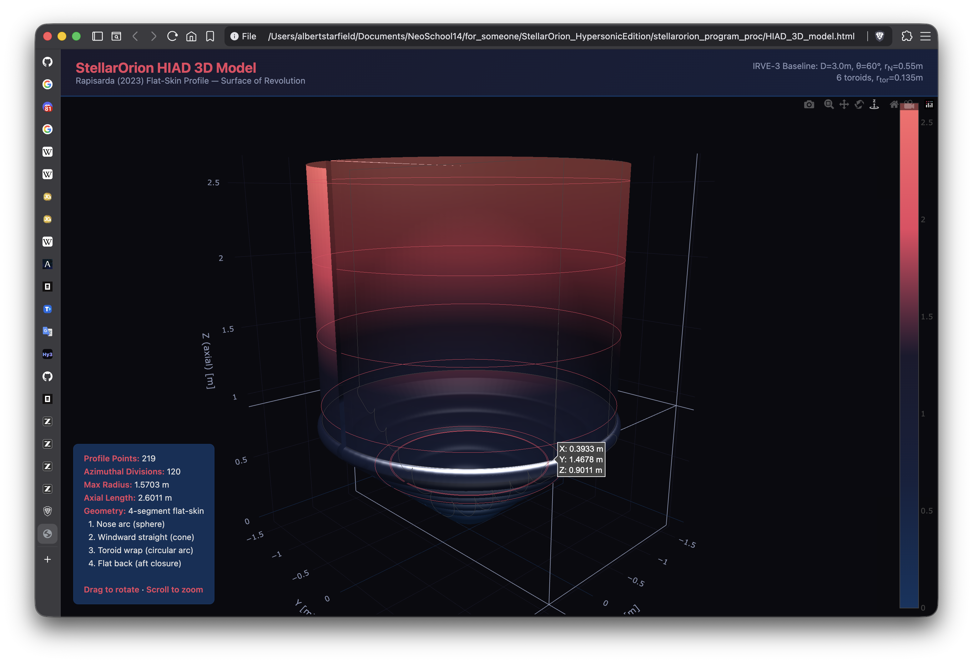

Slide 9
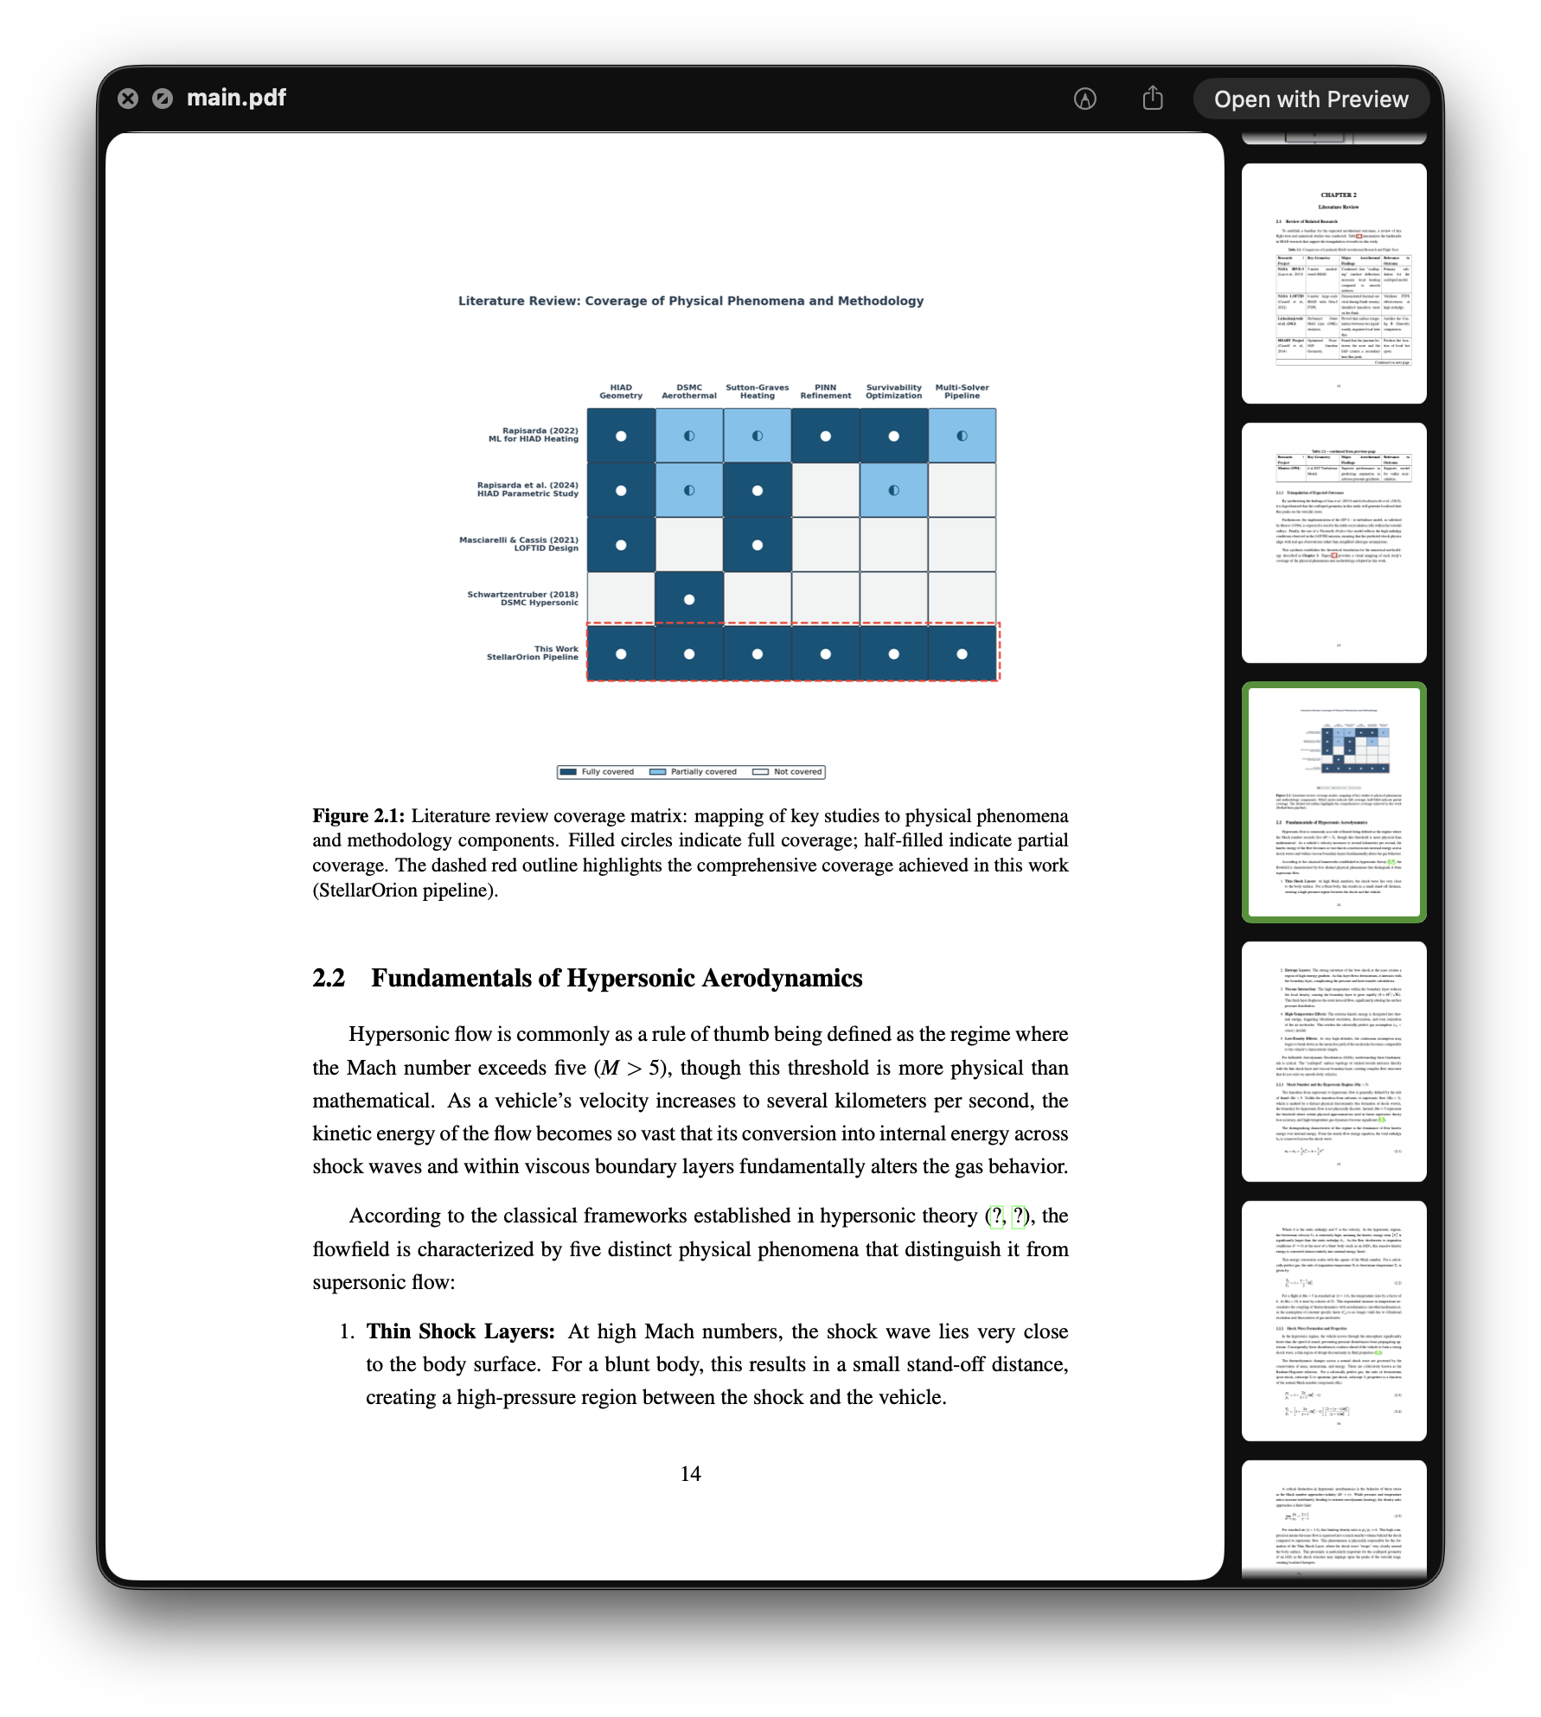
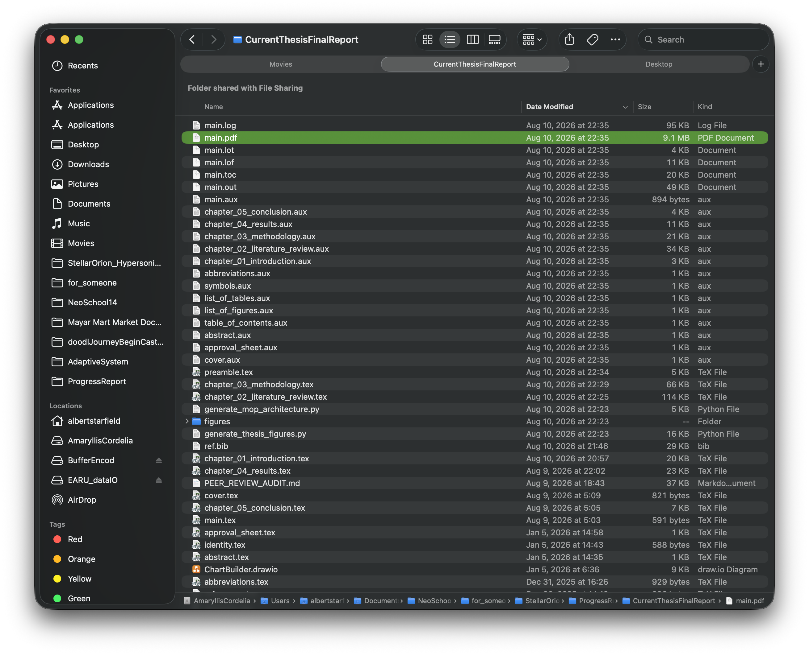
Draft for final thesis currently on-going
Progress Report Aug 27, 2026
Progress Report Aug 27, 2026

Slide 10
Draft for final thesis currently on-going
Finishing Chapter 1 to Chapter 3 and Placeholder on Chapter 4 and 5 on thesis
Filling in the missing toroids that being submitted into the simulation
Continuing Validation & Calibration.
Excersizing Derivation From Cube Control Volume Variable Sphere (for Thesis Defense Reason)
Progress Report Aug 27, 2026
Progress Report Aug 27, 2026

